Slide 1

Shivratna Shikshan Sanstha Shivratna Institute of Management Studies, Shankarnagar-Akluj.
Case Study - NMK -1 Golden-A
Student Name- 1. Aditi Praveen Pore
2. Neeti Kishor Patel
3. Aarya Santajirao Mane-Deshmukh
4. Bhumika Nitin Bhongle
5. Aamir Aliasgar Dahodwala

Slide 2
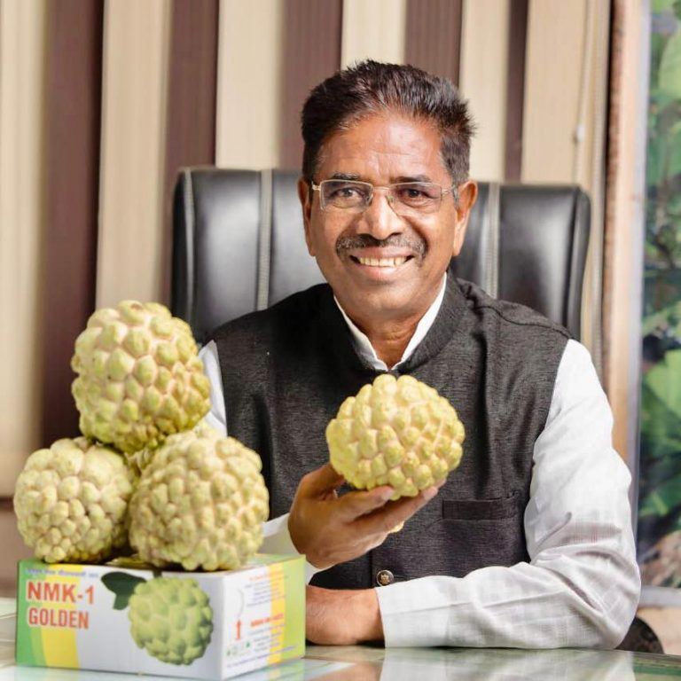
NMK -1 Golden-A Case Study
This case study is of a successful farmer, scientist, entrepreneur and a man who redefined the farming of custered apple.
Dr . Navnath malhari kaspate, sixty five years old farmer lives in Gormale village, drought prone area of barshi, in solapur district.
11th class drop out.
Engaged in grapes farming, on 45 acre of land.

Slide 3
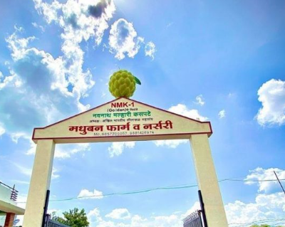
THE BEGINNING
One day in his farm he found one typical plant of custard apple.
He observed that the fruits of the plant are far better than the normal custard apple variety like Balanagari.
He further found that harvesting time and shelf value of the fruit is more than the normal custard apple.
Harvesting and perishability were the main problems in custard apple farming.
Dr. Kaspate decided to grow and nurture this variety as a solution to the problem.

Slide 4
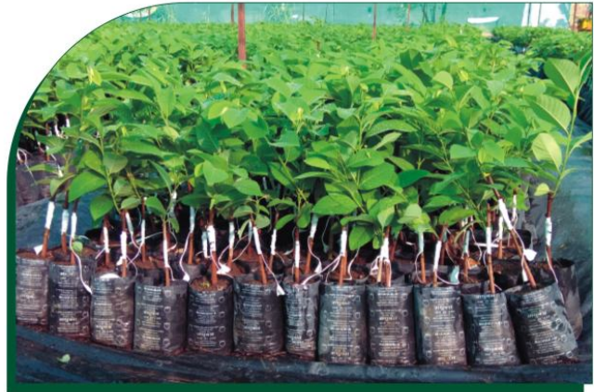
PLANTATION
Dr. Kaspate started grafting from this plant.
After on year he planted one acre of this new variety in his farm.
After three years he could earn good money out of this experiment.
He then decided to make this innovation available to the farmers of the country.

Slide 5

HISTORY OF NMK-1 GOLDEN
Begin growing in 1986
Madhuban farm & nursery in 1996
Custard apple research center.
42 variety of custard apple.
10 years of research for best variety

Slide 6
FEATURES OF THE VARIETY.
Superior variety was named as nmk-1 golden
Nmk is the initials of name of dr. navnath malhari kaspate and It is golden in colour.
Fruit pulp=60 to 70%
No. of seeds = 15-20
Avg weight=6000-1000gms
Water is needed during its initial 2 years then water is not needed summer.

Slide 7
INCOME OF THE FARMER
Selling price of nmk-1 golden is 100/150 Rs. per kg
400- 850 plants are planted in one acre
(Plant distance 5*10 to 8*12)
Averagely 400 plants in acre 400 plants*10kg= 4000 kg fruits 4000 kg * 100 = 400000.00 Rs.
In Madhuban farm 25 acre land* 7,81,250 Rs=1,95,31,250/- Rs. Average 2 crore income is earned
Life of the Plant is considered to be more than 7 Years.

Slide 8
Achievements
Awarded with the medals and certificates.
Rewards and recognition.
Students of Agriculture from Punjab are perusing Ph.D. at Madhuban Farm.

Slide 9
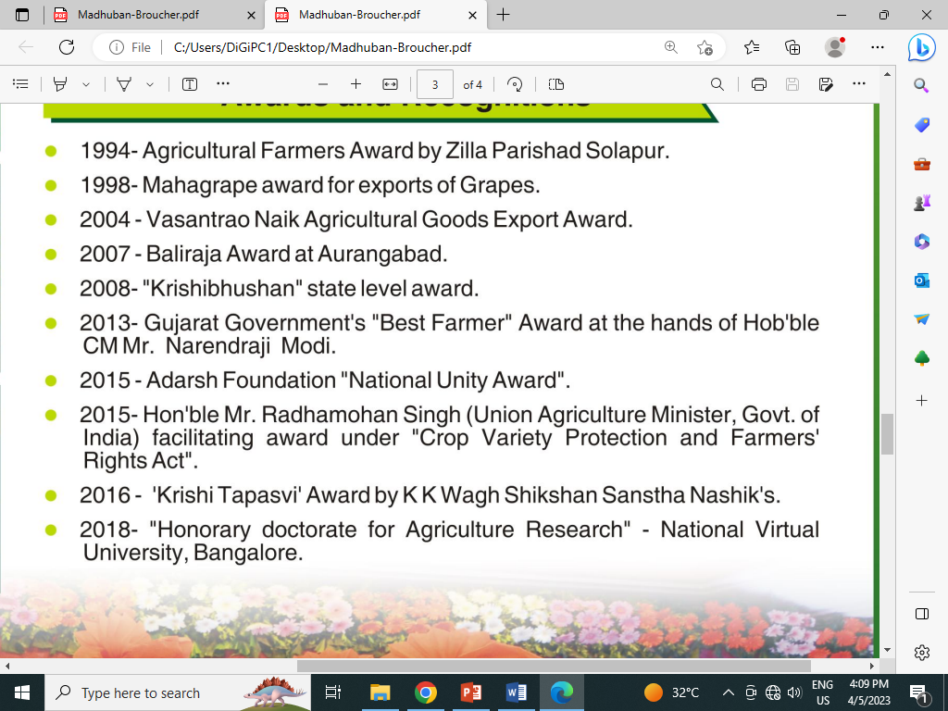
AWARDS

Slide 10
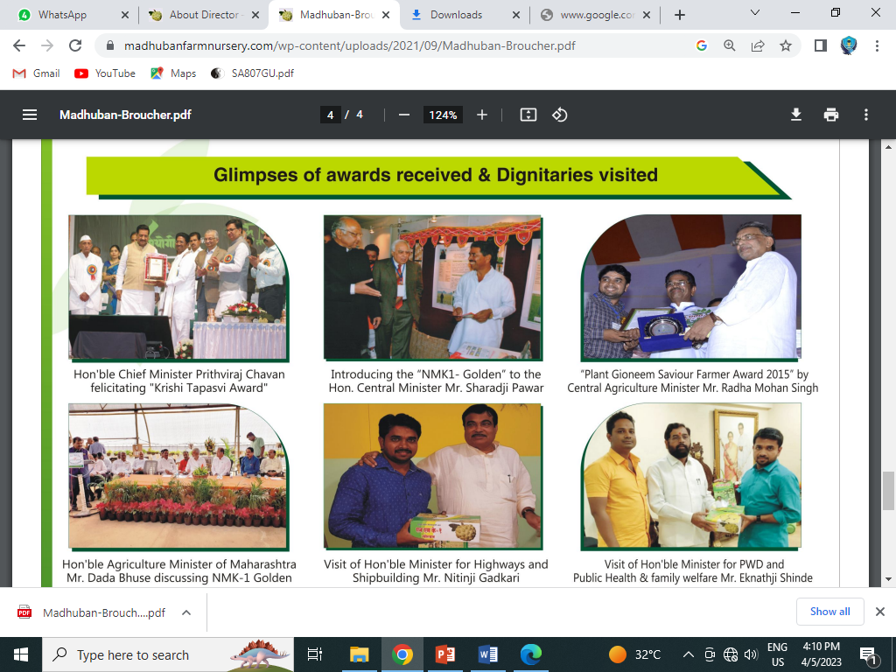
Gallery

Slide 11
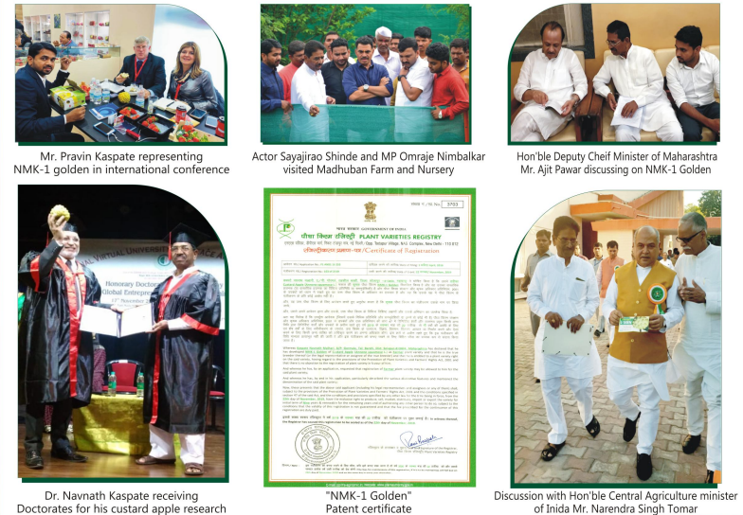
Gallery

Slide 12
Conclusion
Farmers are generally treated as illiterate and do not have the skills. The present case of Dr. Navnath Malhari Kaspate has proved that farmers also can do research through their experience, bring innovation in their profession and beyond that the innovation is so useful to the society at large that it can make huge changes in the life of lakhs of farmers in terms of their financial gains and the increased standard of living.

Slide 13


